Slide 1
Chapter-9 Three-Phase Circuits
Subrahmanyam Gorthi
Department of Electrical Engineering, IIT – Tirupati
Email: s.gorthi@iittp.ac.in
Office: Faculty Room No: 6(E)

Slide 2
Outline
Balanced Three-Phase (3-Φ) Voltages
Balanced Y-Y Connections
Balanced Y-Δ Connections
Balanced Δ-Δ Connections
Balanced Δ-Y Connections
Power in Balanced Systems

Slide 3
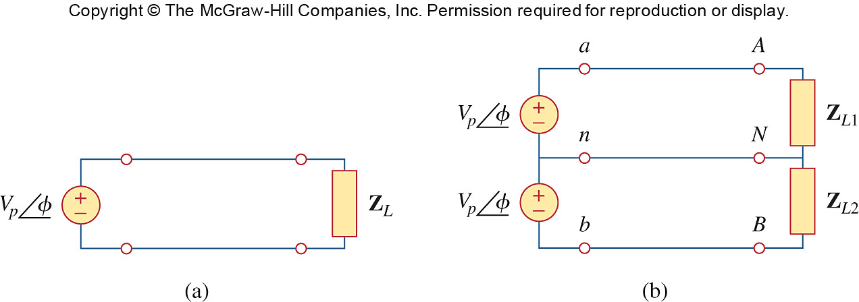
Single-phase system: 2-wire type and 3-wire type

Slide 4
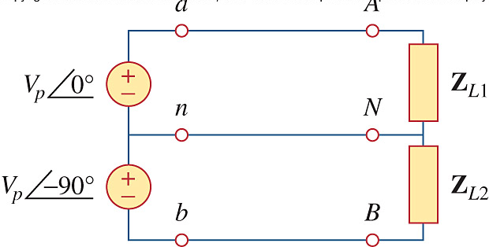
Two-phase 3-wire system

Slide 5
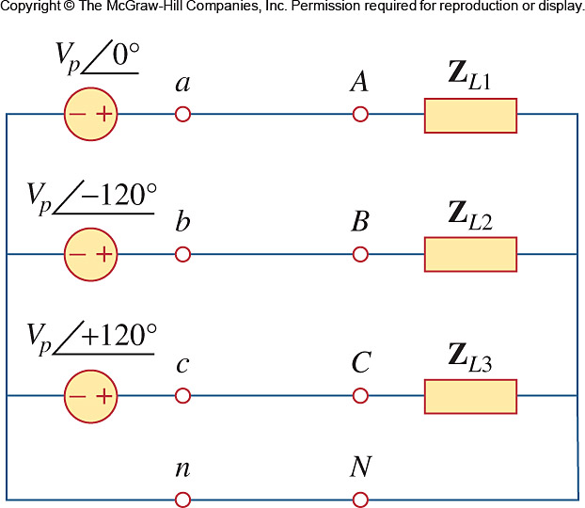
Three-phase 4-wire system

Slide 6
Poly-Phase Circuits
Circuits / systems in which the AC sources operate at the same frequency, but different phases are known as poly-phase circuits/systems.
Since 3-phase system is by far the most prevalent and the most economical system, the discussion in this chapter is mainly on them!
Balanced phase voltages are equal in magnitude and are out of phase with each other by 120°.
A balanced load is one in which the phase impedances are equal in magnitude and in phase.

Slide 7
Three-Phase Circuits
Advantages:
Most of the electric power is generated and distributed in three-phase.
The instantaneous power in a three-phase system can be constant. This results in uniform power transmission, less vibration of 3-phase machine.
The amount of power, the three-phase system is more economical that the single-phase.
In fact, the amount of wire required for a three-phase system is less than that required for an equivalent single-phase system.

Slide 8
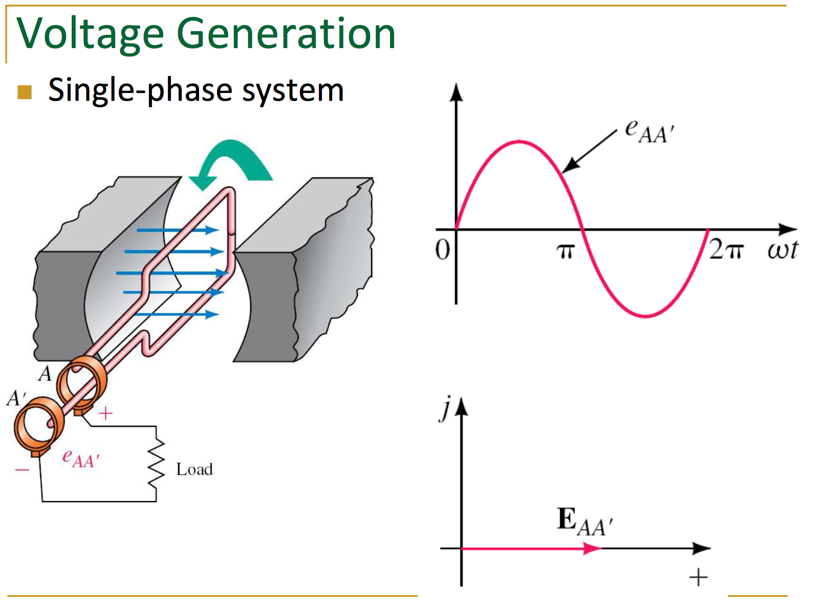

Slide 9
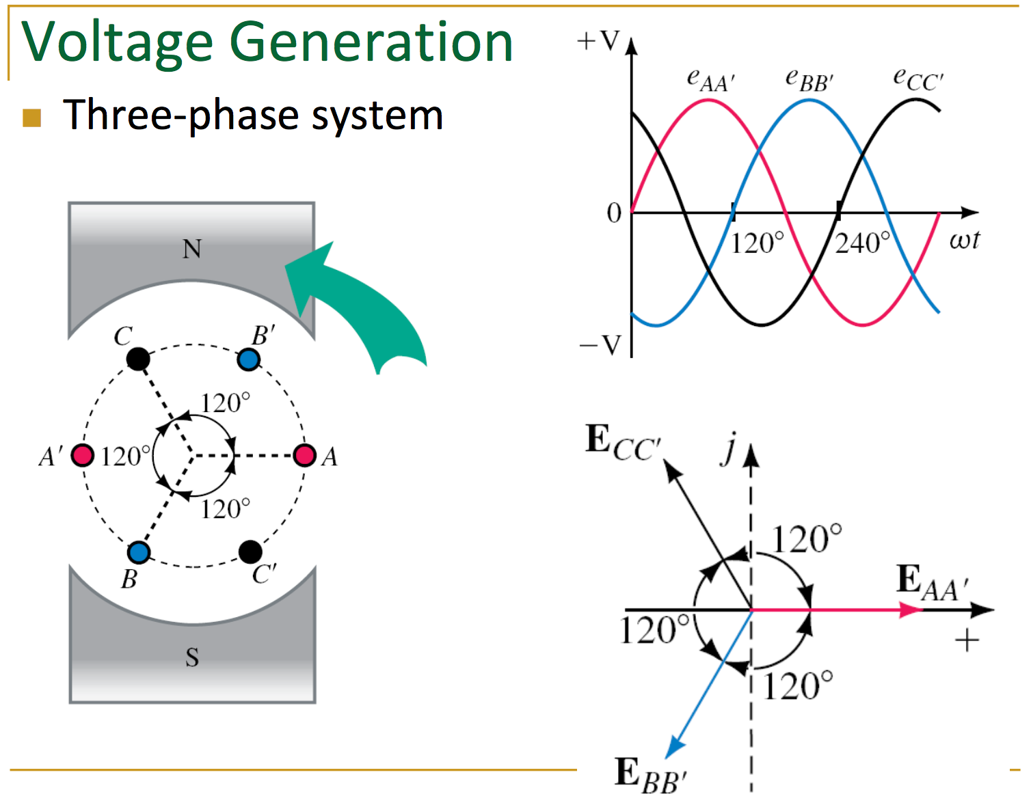

Slide 10
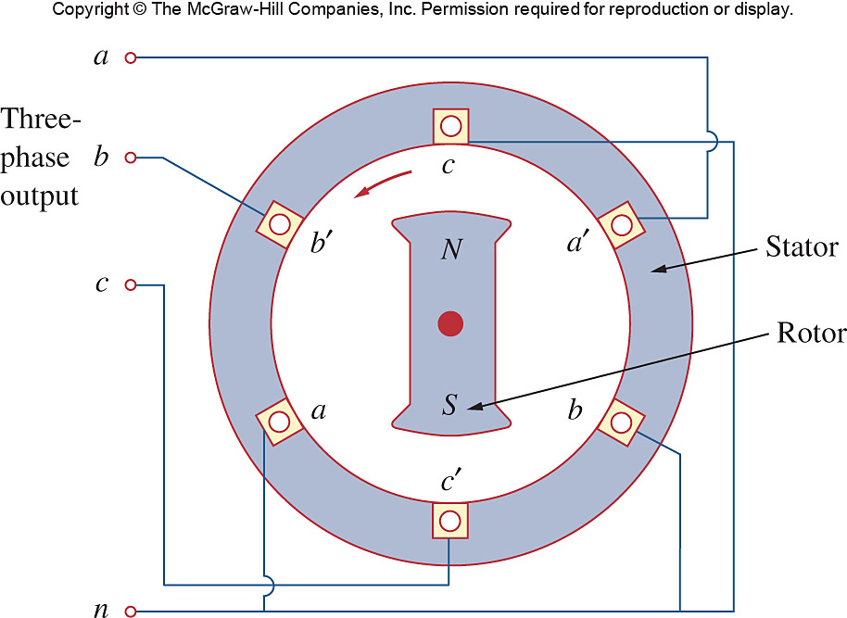

Slide 11
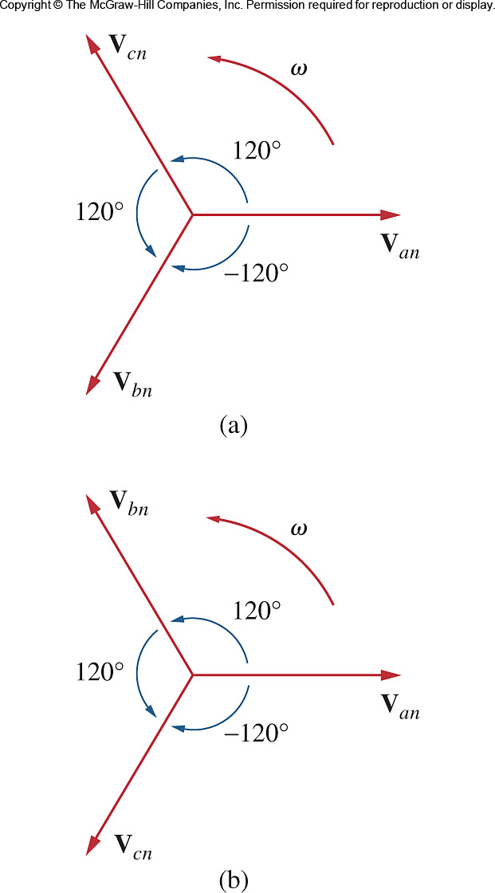
(a) abc or Positive sequence
(a) acb or Negative sequence

Slide 12
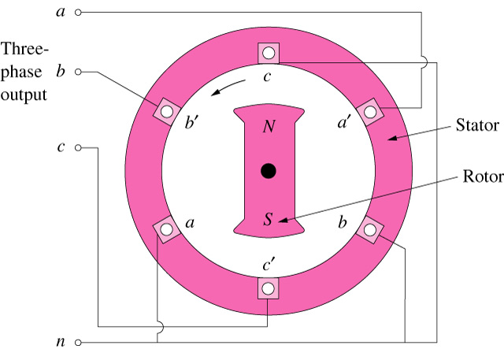
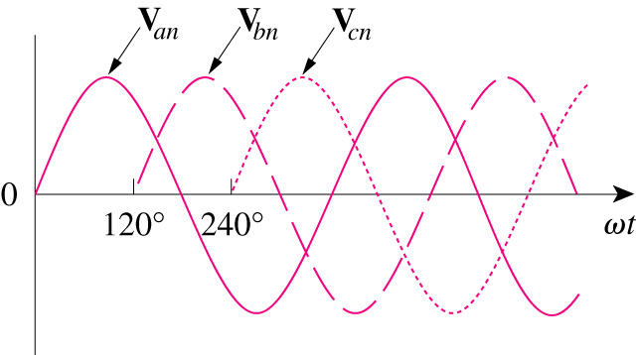
Balanced Three-Phase Voltages
A three-phase generator consists of a rotating magnet (rotor) surrounded by a stationary winding (stator).
A three-phase generator
The generated voltages

Slide 13
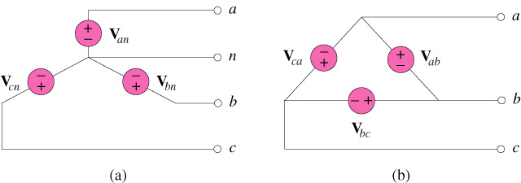
Balanced Three-Phase Voltages
Two possible configurations:
Three-phase voltage sources: (a) Y-connected ; (b) Δ-connected

Slide 14
Balanced Three-Phase Connection
Four possible connections
Y-Y connection (Y-connected source with a Y-connected load)
Y-Δ connection (Y-connected source with a Δ-connected load)
Δ-Δ connection
Δ-Y connection

Slide 15
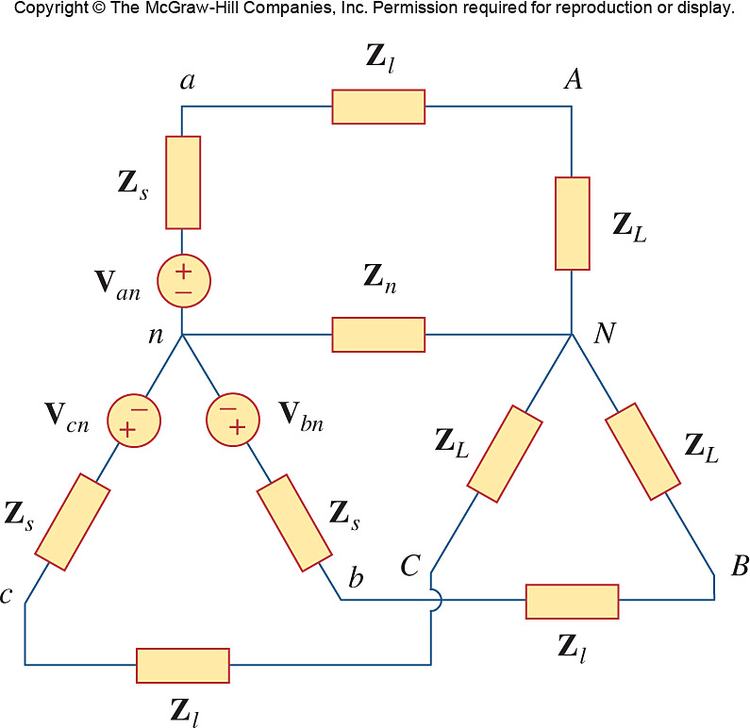
Balanced Three-Phase Connection

Slide 16
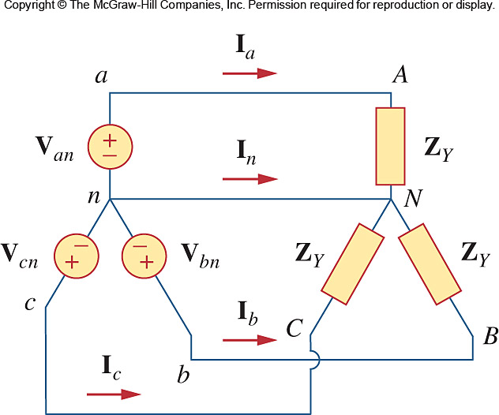
Balanced Three-Phase Connection

Slide 17
Balanced Three-Phase Connection
A balanced Y-Y system is a three-phase system with a balanced y-connected source and a balanced y-connected load.

Slide 18
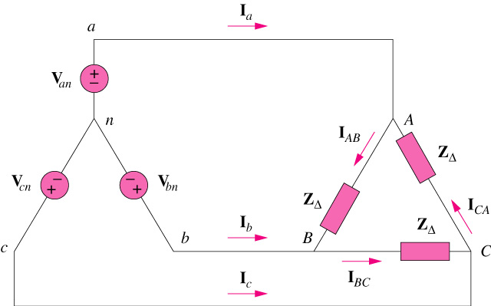
Balanced Three-Phase Connection
A balanced Y-Δ system is a three-phase system with a balanced y-connected source and a balanced Δ-connected load.

Slide 19
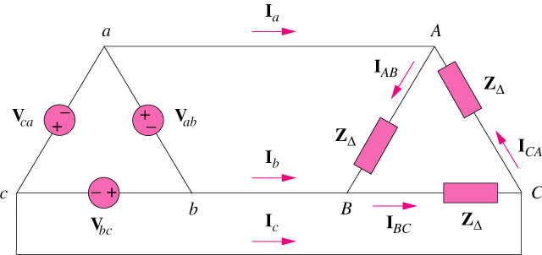
Balanced Three-Phase Connection
A balanced Δ-Δ system is a three-phase system with a balanced Δ -connected source and a balanced Δ -connected load.

Slide 20
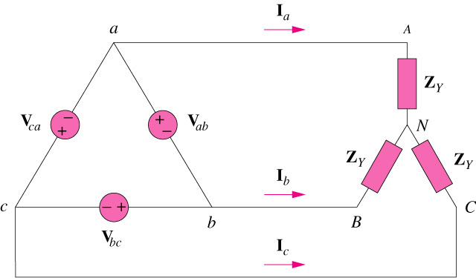
Balanced Three-Phase Connection
A balanced Δ-Y system is a three-phase system with a balanced y-connected source and a balanced y-connected load.

Slide 21
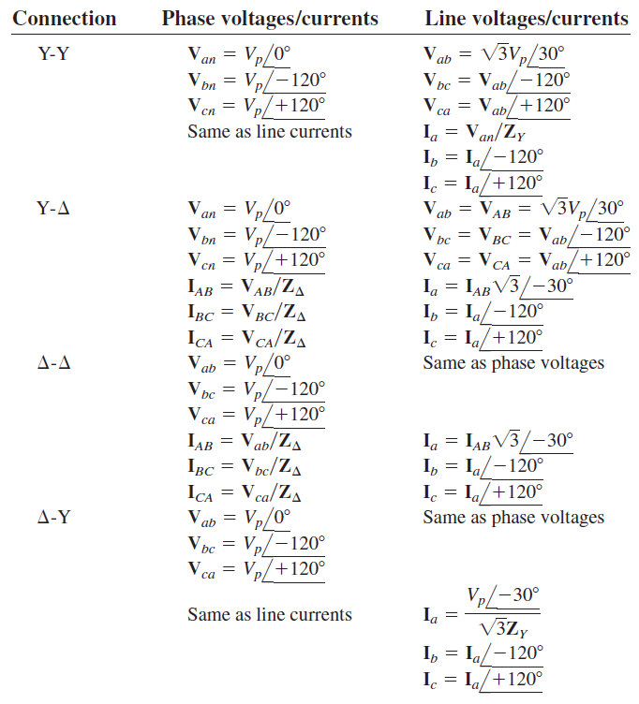

Slide 22
Balanced Three-Phase Voltages
Example 1
Determine the phase sequence of the set of voltages.

Slide 23
Balanced Three-Phase Voltages
Solution:
The voltages can be expressed in phasor form as
We notice that V_{an} leads V_{cn} by 120° and V_{cn} in turn leads V_{bn} by 120°.
Hence, we have an acb sequence.

Slide 24
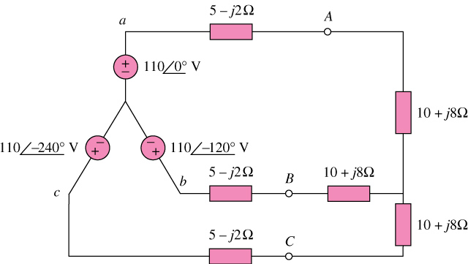
Balanced Three-Phase Connection
Example 2
Calculate the line currents in the three-wire Y-Y system shown below:

Slide 25
Balanced Three-Phase Connection
Example 3
A balanced abc-sequence Y-connected source with ( ) is connected to a Δ-connected load (8+j4)Ω per phase. Calculate the phase and line currents.
Solution
Using single-phase analysis,
Other line currents are obtained using the abc phase sequence

Slide 26
Balanced Three-Phase Connection
Example 4
A balanced Δ-connected load having an impedance 20-j15 Ω is connected to a Δ-connected positive-sequence generator having ( ). Calculate the phase currents of the load and the line currents.
Ans:
The phase currents
The line currents

Slide 27
Balanced Three-Phase Connection
Example 5
A balanced Y-connected load with a phase impedance 40+j25 Ω is supplied by a balanced, positive-sequence Δ-connected source with a line voltage of 210V. Calculate the phase currents. Use V_{ab} as reference.
Answer
The phase currents

Slide 28



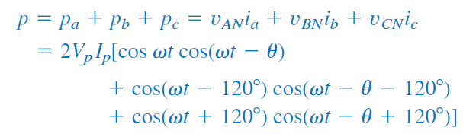
Power in a Balanced Y-Load System

Slide 29
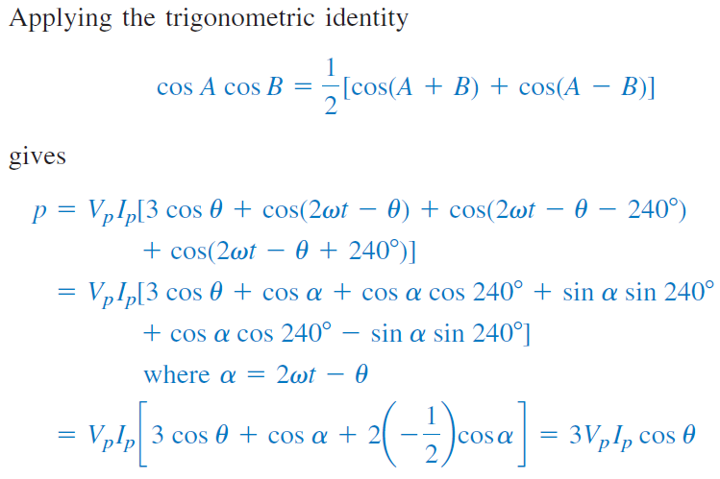
Power in a Balanced Y-Load System

Slide 30
Power in a Balanced System
Thus the total instantaneous power in a balanced 3-Φ system is constant – It does not change with time.
The result is true whether the load is Δ or Y.
This is one important reason for using 3-Φ system to generate and distribute power.

Slide 31




Power in a Balanced System
Average power per phase:
Reactive power per phase:
Apparent power per phase:
Complex power per phase:

Slide 32
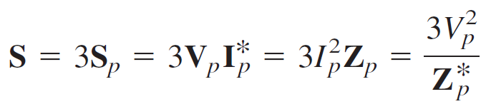

Power in a Balanced System
Total Average Power:
Total Reactive Power:
Total Complex Power:
Alternative Expression for Total Complex Power:

Slide 33
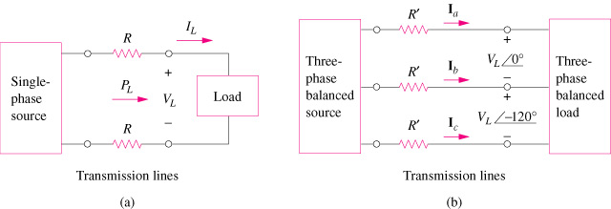
Power in a Balanced System
Comparing the power loss in (a) a single-phase system, and (b) a three-phase system

Slide 34
Balanced Three-Phase Connection
Example 6
Determine the total average power, reactive power, and complex power at the source and at the load for the three-wire Y-Y system shown below:

Slide 35
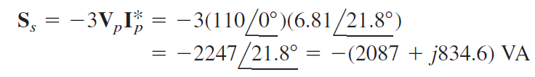
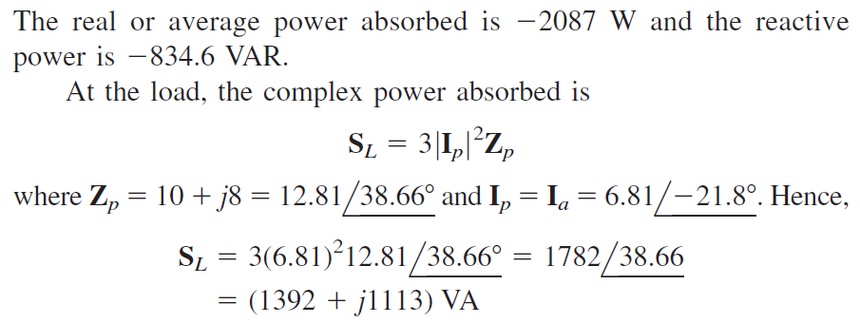
Balanced Three-Phase Connection
Solution:

Slide 36
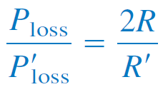
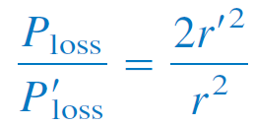
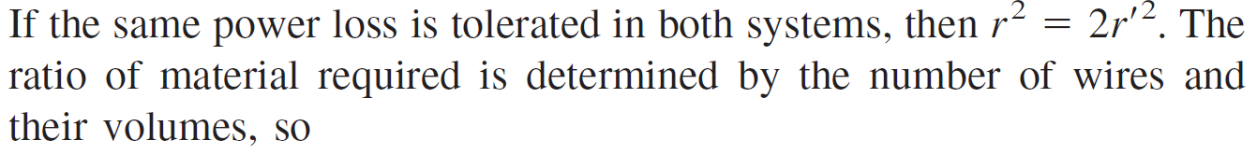
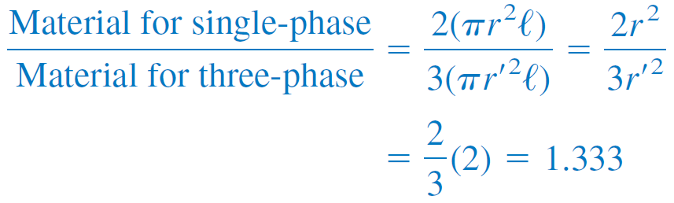
Power in a Balanced System
If same power loss is tolerated in both system, three-phase system use only 75% of materials of a single-phase system

Slide 37

Questions?

